Slide 1


Capstone Project Phase B
Relational Generative Adversarial Networks For Graph-Constrained House Layout Generation
Supervisors:
Ph.D. Dvora Toledano – Kitai
Prof. Zeev Volkovich
Students:
Yeela malka
Yael Shusterman

Slide 2
Table Of Content
Introduction
The Problem Statement
Background
The Research Process
The Model
Pre-Trained Setup
Pre-Processing Dataset
Pre-Trained Flow
Results
Video
Diagrams
Testing plan
Conclusion

Slide 3
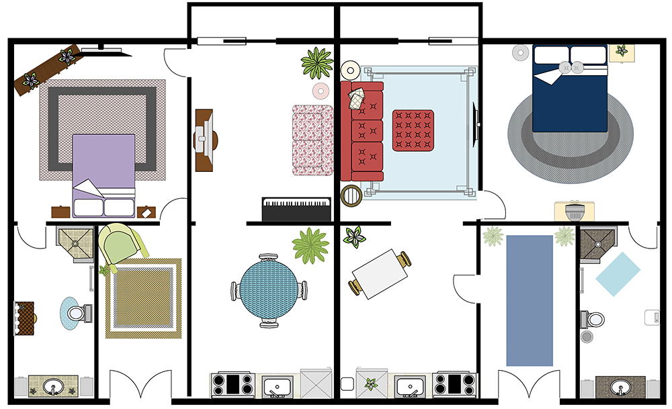
INTRODUCTION
There are several steps involved in designing floor plans for a house:
Firstly, the customer consults an architect to create floor plans.
The architect create ‘bubble diagram’.
Then, the floor plans are generated and modified multiple times based on customer feedback.
This entire process is time consuming and expensive.
Thus, a demand for automation this process is created.
Notes:
The architect create ‘bubble diagrams’(by using considerations like: the types of rooms, the number of rooms, and of course, which rooms should be near to each other.

Slide 4
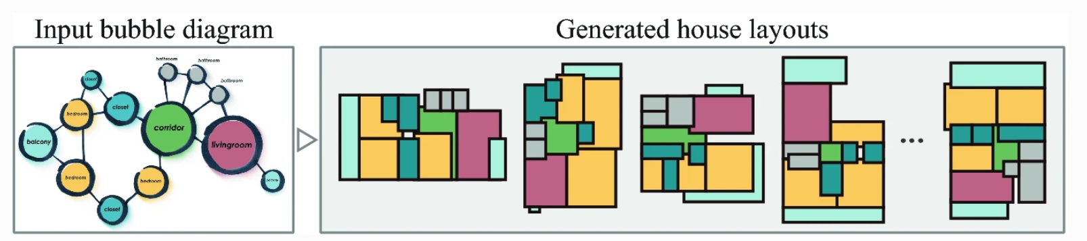
The Problem Statement:
The problem can be efficiently resolved by GAN (Generative Adversarial Networks)
Development of a GAN taking into account architectural constraints as a graph as input and producing a set of axis-aligned bounding boxes of rooms.
Notes:
. we can efficiently resolve this with gan by develop a gan that take into account architectural constrained as a graph as input and producing a set of axis aligned bounding boxes of rooms.In this graph, each room is represented as a node and the type of room is embedded as node information.
The spatial adjacency is represented as an edge between two nodes

Slide 5
Background
1. GAN notion
2.W-GAN
3.MPN
4.CONV-MPN
Notes:
Before we dive into the model and implementation we will have to briefly explain some concepts.

Slide 6
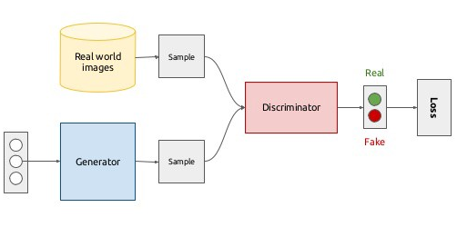
Generative Adversarial Network
Generative machine learning model-to generate artificial objects.
Consists of two main components: Generator and Discriminator .
GAN’s Process:aims to study the Generator until its output will fool the Discriminator.
Notes:
It is a type of model that consists of two neural networks: a generator network and a discriminator network.
GANs are used for generating synthetic data.
The generator network learns to generate new samples.
The discriminator network, on the other hand, learns to distinguish between real data from the training data and fake data.
The generator aims to produce realistic samples that can fool the discriminator,
while the discriminator aims to distinguish better between real and fake samples.

Slide 7
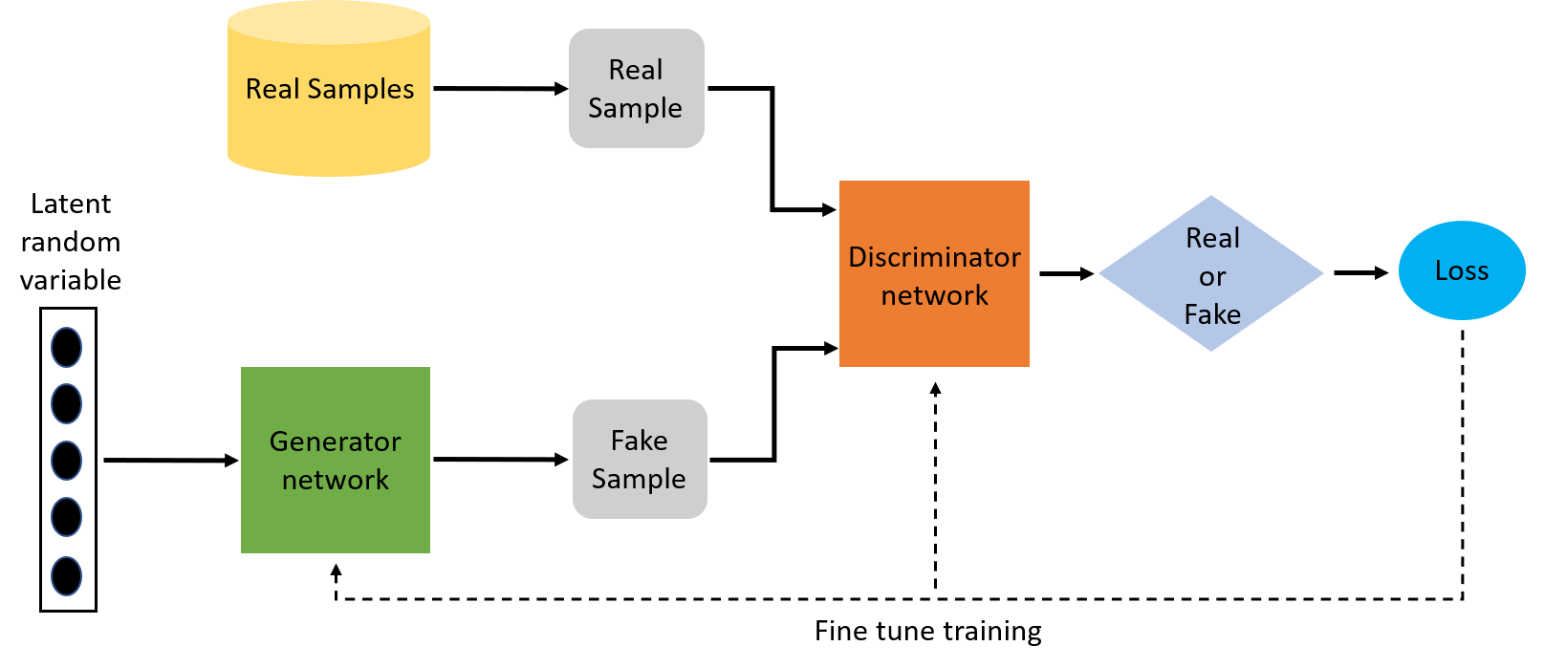
W-GAN Loss Function
Loss function: Computes the difference between the current output and the expected output of the neural network algorithm.
W-GAN: Based on the Wasserstein distance concept, it estimates the distance (loss function) between probability distributions in the context of GANs.
Wasserstein distance: A mathematical measure of dissimilarity between two probability distributions.
Notes:
It quantifies the minimum "work" or "effort" needed to transform one distribution into another.
.

Slide 8
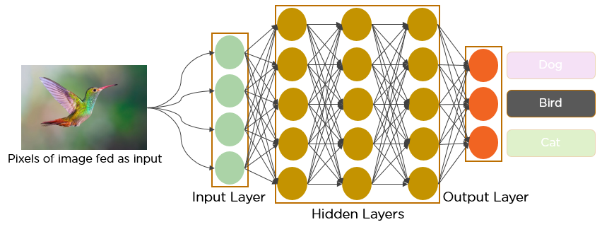
Convolutional Neural Network(CNN)
It is an algorithm used mainly for analyzing images and videos. CNNs learn nested levels of details.
CNNs have proved to be a great way to deal with visual data.
However, in many real-world problems, the input data for a problem is not easily captured in the format of an image
Notes:
.
For example, connectivity of the rooms can be modelled as graphs. Wouldn’t it be great if there was a way to create deep learning models that can take a graph of random size as input? This is where Message Passing Networks (MPNs) come in.

Slide 9
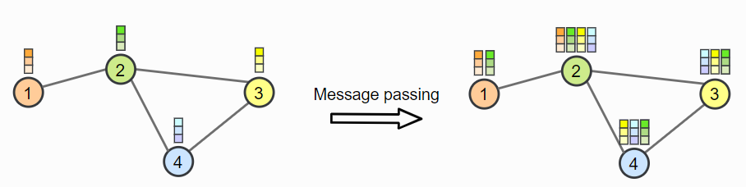
Message Passing Networks (MPN)
MPNs are neural networks that can handle data represented in graph form.
MPN work by exchanging information between the nodes of a graph:
1. Each node in the graph has a representation.
2. Nodes send messages to their neighboring nodes.
3. Nodes receive messages from their neighbors and combine
them to update their own representation.
4. The process is repeated.
Notes:
This process is repeated for multiple iterations, allowing information to spread across the graph.
MPNs are good at capturing relationships and interactions between elements in structured data

Slide 10
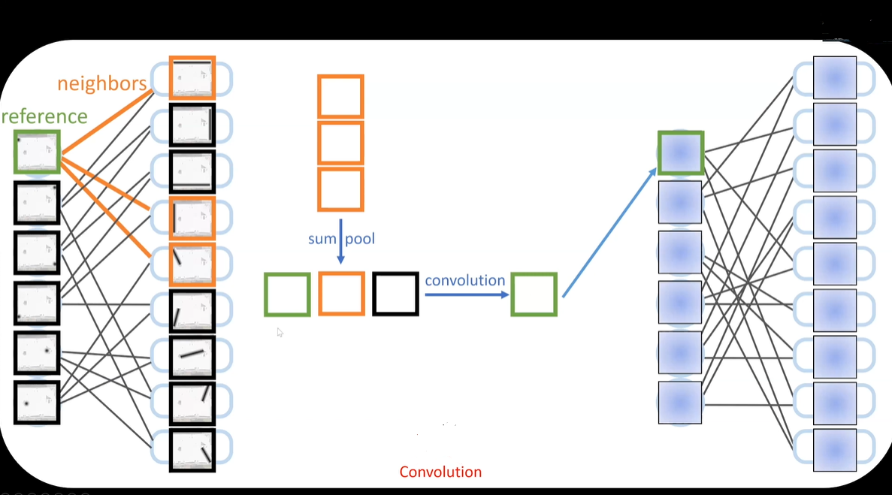
Conv-MPN
Conv-MPN uses feature volumes instead of feature vectors as node states.
Since the task in HouseGAN involves spatial relationships, by using Conv-MPN, HouseGAN can better understand the spatial nature of the problem and generate more realistic floor plans for houses.
Notes:
Conv-MPN a version of MPN.
The main difference is that Conv-MPN uses feature volumes instead of feature vectors as node states.
since the task in HouseGAN involves spatial relationships, so having more dimensions in the hidden state makes sense.
To create messages, Conv-MPN uses a CNN architecture, which helps capture spatial patterns effectively.
By using Conv-MPN, HouseGAN can better understand the spatial nature of the problem and generate more realistic floorplans for houses.

Slide 11
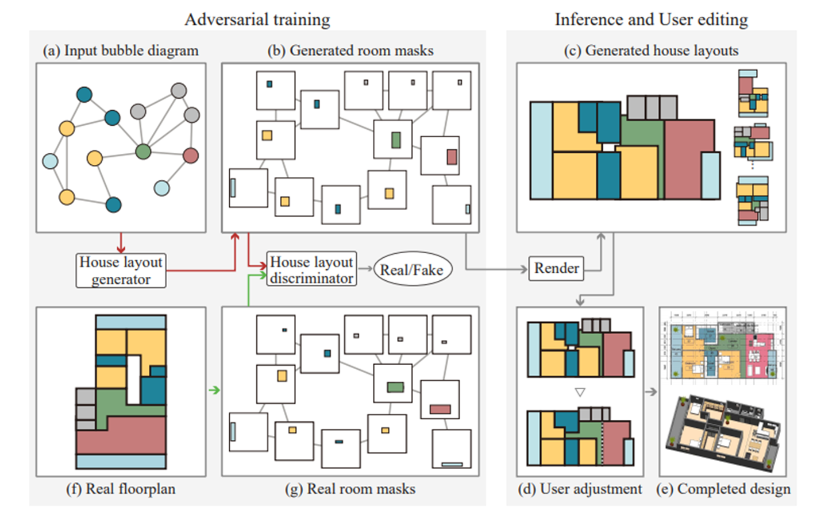
HOUSEGAN Model Overview:
Notes:
Before yeela dive in the details of the model, I want to explain it in high leve .so we have generator and discriminator
.the generator
Takes a bubble diagram and generates room segmentation masks.
Uses a series of neural network layers to transform room descriptions into detailed room layouts.
Starts with random noise and room type information, then processes through upsampling and convolutional layers to create masks.
Takes generated room segmentation masks and distinguishes them from real ones.
Incorporates room type information and segmentation masks.
Uses a series of neural network layers to analyze the structure of the generated masks and determine authenticity.

Slide 12
The Research Process
The Goal: Implementation of HOUSEGAN
Challenge one: Portions of the code needed to modified
Challenge two: Imported packages were deprecated.
Challenge three : Access to dataset.
Successfully code running
Notes:
The article has a git repository for the model which consists to models the training model and pre trained model. We decided to start to try running first the pre-trained model. Along the way, we face some challenges.
first Certain portions of the code that were written in a "hard-coded" way needed to be modified (file paths, for example) so we spent a lot of time changing lines in the code.
Secondly
several of the imported packages in the Python were deprecated or from old
versions, while Google Colab is using the most recent versions by default
so we needed to understand deeply the dependencies between the packages and the
libraries for fixing this problem.
the last
challenge was about the dataset. our project used full homes database and it
Requires permission to access so we needed to fill application for this and it
takes time until we get the permission.
After running this model successfully, we tried to run the training model . in this model we also faced challenges that some of them we solved but after spending a lot of time on the pre-trained model we consulted our supervisor and decided that the training model would be a base for the following research and we will dive in the pre-trained model.

Slide 13

Pre-Trained Setup:
Framework :Implemented in PyTorch.
Hardware: Utilized a workstation with dual Xeon CPUs and dual NVIDIA Titan RTX GPUs.
Training :WGAN-GP with ADAM optimizer (b1=0.5 b2=0.999), trained for 200k iterations.
Learning Rates:Generator (0.0001), Discriminator (0.0001).
Batch Size: 32.
Notes:
We have implemented the proposed architecture in PyTorch which is an open-source deep learning framework that provides a flexible and dynamic computational graph structure .
we utilized a workstation with dual Xeon CPUs and dual NVIDIA Titan RTX GPUs. it provides a powerful and efficient platform for training deep learning models, particularly for tasks requiring high computational power, such as generating realistic images with GANs.
Our model use WGAN with ADAM optimizer with these values and is trained for 200k iterations.
The learning rates of the generator and the discriminator are 0.0001, respectively. The batch size is 32.
opt values:Overall, these values balance between adaptability (through quick updates based on recent gradients) and stability (by smoothing the updates with respect to variance). They are often considered as reasonable defaults and are widely used in deep learning frameworks like PyTorch and TensorFlow.
Overall, setting both the generator and discriminator learning rates to \(0.0001\) aims to strike a balance between stability, convergence, and avoiding mode collapse, while also aligning with the properties of the chosen optimizer.
Batch size refers to the number of training examples used in one iteration of model training. In deep learning, including with GANs (Generative Adversarial Networks), training data is typically divided into smaller batches to make computations more manageable.
- A batch size of 32 has been commonly used and found to work well in many GAN architectures and tasks.
- It has become somewhat of a default choice for GAN training due to its balance between stability and computational efficiency.
PyTorch is an open-source deep learning framework primarily developed by Facebook's AI Research lab (FAIR). It provides a flexible and dynamic computational graph structure, making it particularly well-suited for research and experimentation in deep learning.

Slide 14
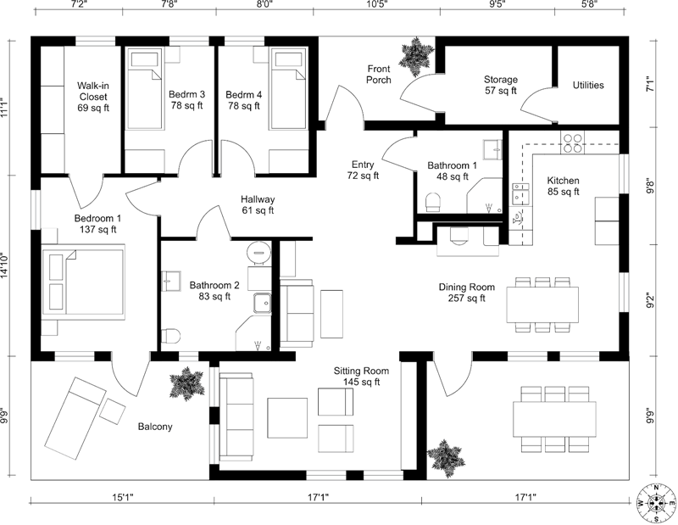
Preprocessing Dataset
LIFULL HOME’S contains five million real RGB floorplan images
from which we retrieved 117,587
Preprocessing:
Step 1: rescale all floorplan images to fit inside the 256x256 resolution.
Step2: a vectorized version of the floorplan is created.
Step3: convert the vectorized floorplan into a bubble diagram.
The bubble diagram is used as input for the model .
Notes:
A few preprocessing steps are applied to these raw RGB images before they are used by the model.
The first step is to uniformly rescale all floorplan images to fit inside the 256x256 resolution.
After this rescaling, a vectorized version of the floorplan is created. This is done by a floorplan vectorization algorithm.
The last step is to convert this vectorized floorplain to in a bubble diagram. The bubble diagram is used as input for the model.

Slide 15
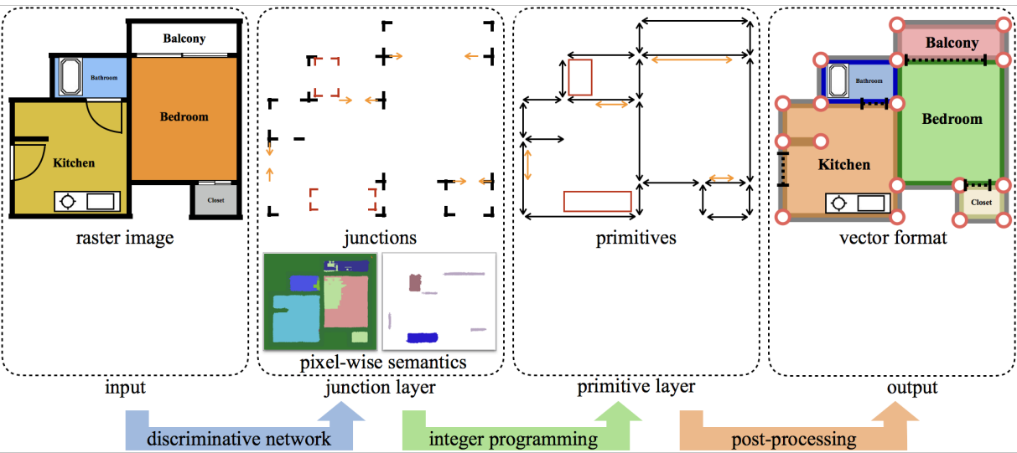
Create a vectorized version of the floorplan
"Raster-to-Vector" steps:
1.The RGB floorplan image is fed into the CNN, which produces two outputs: Wall junctions, Room classification scores.
2. Taking the wall junction and generating a set of "primitives.“(represent structures like walls and doors).
3. Combining the 1+2 results to create the final vectorized floorplan representation.
Notes:
we use "Raster-to-Vector" (RtV) method To construct a vectorized floorplan from an RGB image .
this method consists of several steps:
1.The RGB floorplan image is fed into the CNN, which produces two outputs:
Wall junctions: These are the corners and intersections of walls in the floorplan.
Room classification scores: These scores determine the type of each area in the floorplan, like bedroom, kitchen, etc.
2: Another step involves using a algorithm called Integer Programming. It takes the wall junctions from the previous step and generates a set of "primitives.“
These primitives represent important structures like walls, doors, and bathtubs.
Integer Programming makes sure that the floorplan follows certain rules, like rooms being enclosed by walls and no holes except for doors.
Post Processing: The last step is post-processing.
Here, the generated primitives and room classification scores are combined to create the final vectorized floorplan representation.

Slide 16
Constructing a bubble diagram
The vectorized floor plan already contains the information about which rooms exist and their room type.
These form the nodes of the bubble diagram.
The edges between the nodes are based on the proximity of the rooms in terms of their Manhattan distance.(If any part of a room is within 8 pixels of another room, the rooms are connected ).
House-GAN, disregards doors – to simplify the problem.

Slide 17
Pre-trained model flow
-
Setup and Imports
Load pre-trained model
Dataset initialization
Model generation
Visualization
Notes:
פה בהתחלה צריך להכניס שאנחנו בשלב זה כבר משתמשים בדאטהסט שהוא בצורת וקטוריזציה

Slide 18
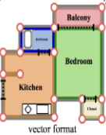
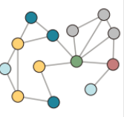
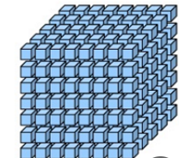
Pre-trained model flow
Load & process dataset, prepare generator input
Load data from dataset using “FloorplanGraphDataset” class
Build generator input by “build_graph” method
Add random noise to generator input by “add_noise” method
Load Generator model and “feed” it with input
Z: “noise” Tensor from previous step nodes: PyTorch Tensors from bubble graph edges: PyTorch Tensors from bubble graph
Data: vectorized floorplan which represented as an vector
generator input: bubble graph represented as 2 NumPy.ndarray (nodes and edges)
generator input addition: 128d vector represented as PyTorch tensor, added to each node
Notes:
פה בהתחלה צריך להכניס שאנחנו בשלב זה כבר משתמשים בדאטהסט שהוא בצורת וקטוריזציה

Slide 19
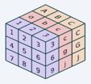

Pre trained model Flow- Generator
Concatenate given noise vector to each node
Reshape each vector using “l1”- fully connected layer
Apply CONV-MPN by “cmp.forward” method: gather information about “neighbors”
Upsampling
Concatenating sum-pooled feature across connected room
Concatenating sum-pooled feature across non-connected rooms
Apply 3 CNN layers: input: 3 tensors (nodes, sum pooling on neighbors, sum pooling on non-neighbors
output: list of vectors of size 16
noise vector: 128d vector (PyTorch tensor)
node: 10d vector (room type- one hot encoding)
output: 138d noise vector
input: 138d vector
output: 3D Tensor (8X8X16) - feature volume
input: list of vectors (each one is room)
output: list of 16X16X16 feature volume (3D Tensor)
CONV-MPN number 2
Upsampling number 2
input: list of 3D tensors
output: list of vectors of size 16
output: list of 32X32X16 feature volume (3D Tensor)
Notes:
פה בהתחלה צריך להכניס שאנחנו בשלב זה כבר משתמשים בדאטהסט שהוא בצורת וקטוריזציה

Slide 20

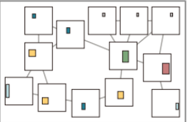
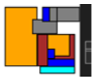


Pre-trained model flow: Visualization -render final output
Create a bounding box for each mask using the "mask_to_bb" method.
Use the "bb_to_vec" method to create room segmentation mask
Draw each floorplan by “draw_masks” method
Use “draw_graph” for display the original bubble graph
generator mask
input: 2D NumPy array (mask) output: bb coordinates - list of tuples
input: list obbs coordinates output: list of sets (corner coordinates)
input: bubble graph represented as 2 NumPy.ndarray (nodes and edges)
output: Image
input: segmentation mask output: Image
“display_final_image” method
Every generator output is shown alongside its input; by default, four versions are produced for each input.
Notes:
פה בהתחלה צריך להכניס שאנחנו בשלב זה כבר משתמשים בדאטהסט שהוא בצורת וקטוריזציה

Slide 21
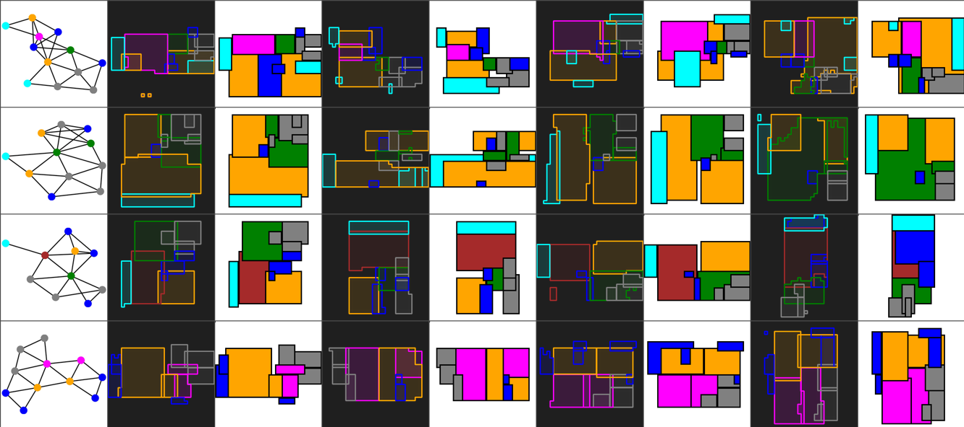
Results

Slide 22
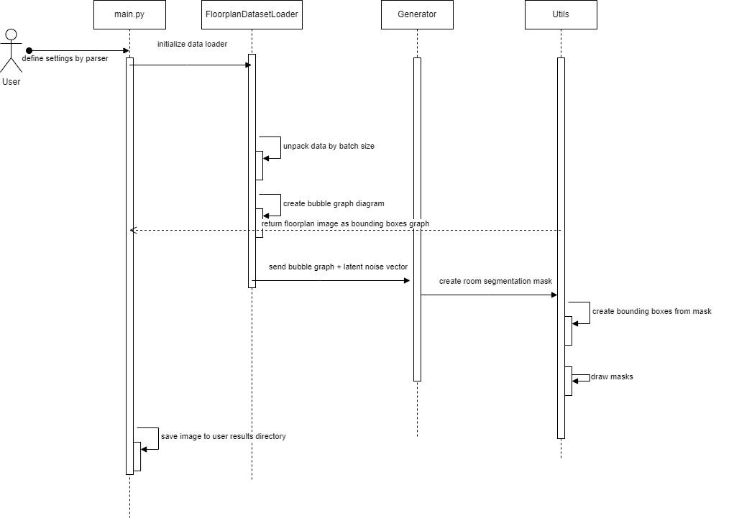
Sequence Diagram

Slide 23
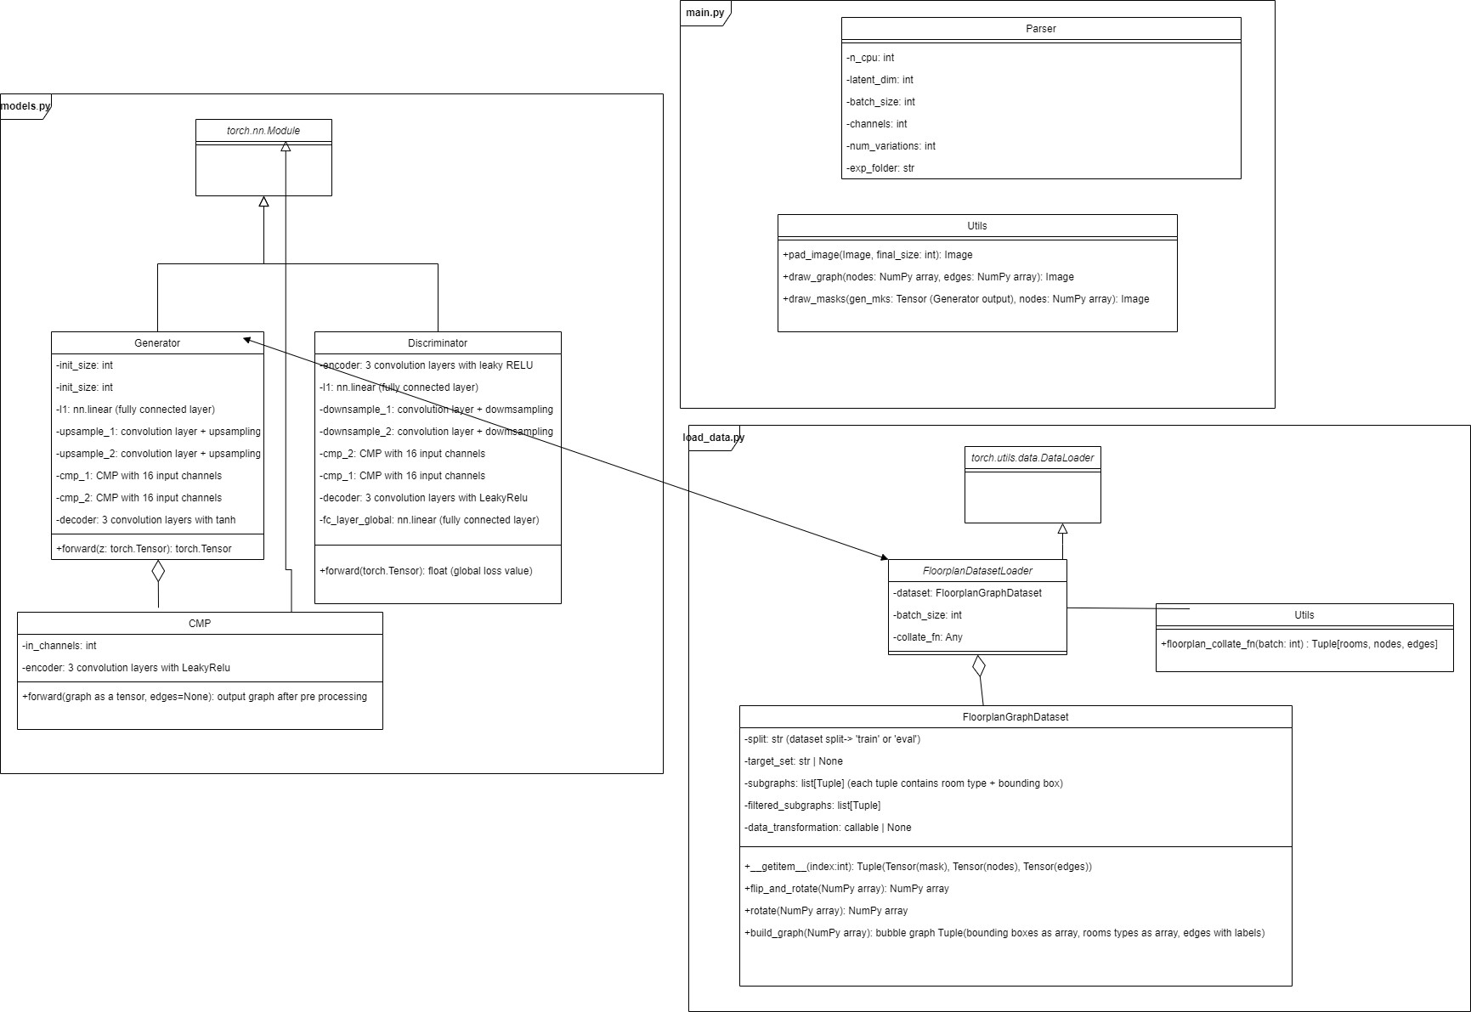
Class Diagram

Slide 24
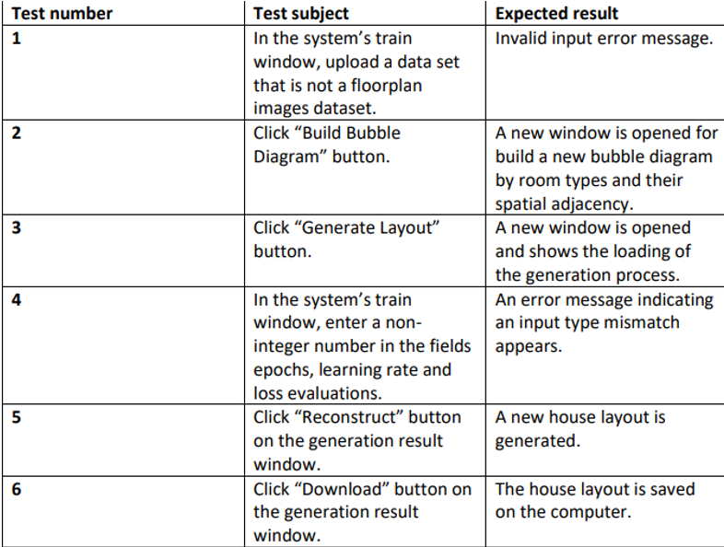
Verification Plan
Planned tests from phase A
Notes:
It is apparent that the intended tests require a gui; however, as we ultimately ran a pre-trained model rather than training model, we were unable to construct the desired GUI for these tests, and new tests were carried out in a different way, adapted to a pre-trained model.

Slide 25

VIDEO

Slide 26

Conclusions
The "HouseGAN" algorithm's outcomes are shown below in comparison to the other algorithms.
HouseGan algorithm outperforms other algorithms in terms of diversity metrics and realism.

Slide 27
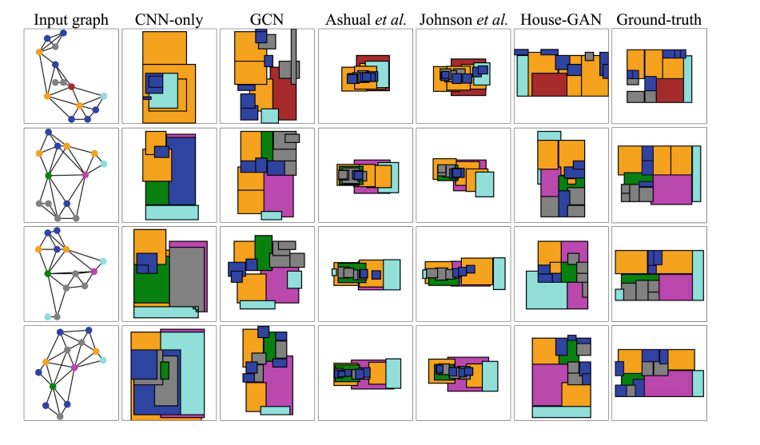
Conclusions
Realism evaluation. House-GAN produces more realistic layouts whose rooms are well aligned and spatially distributed.

Slide 28
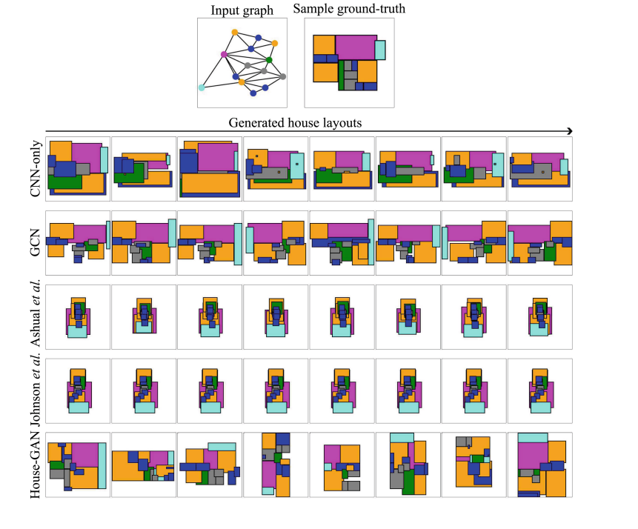
Conclusions
Diversity evaluation: House layout examples generated from the same bubble
diagram. House-GAN shows the most diversity/variations

Slide 29
Thank you!

